Slide 1
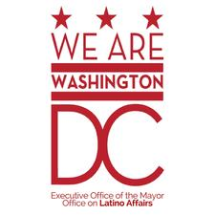
2019 Immigrant Justice Legal Services Grant: Pre-Bidders’ Meeting

Slide 2
Agenda
About the IJLS Grant
Request for Proposals
ZoomGrants
Frequently Asked Questions
Additional Q&A

Slide 3
About IJLS Grant
The Immigrant Justice Legal Services (IJLS) Grant Program is a $900,000 commitment from the Bowser Administration. This grant program funds the provision of legal services, information, and legal resources to the DC immigrant population.

Slide 4
About IJLS Grant: Funding Areas
The program funds services in the following categories:
Legal Education: Conduct Know Your Rights briefings and workshops;
Legal Screenings: Screen persons for possible legal relief; make appropriate referrals to pro bono or paid counsel; provide brief legal consultations
Full legal representation: Help DC residents apply for green cards, convert green cards to citizenship, and make other affirmative USCIS filings; Renew DACA (Deferred Action for Childhood Arrivals) applications and work permits for DC residents or renewing TPS applications; prepare affirmative and defensive asylum applications and provide representation at asylum interviews and/or hearings; represent DC residents who are in removal proceedings, including by filing petitions for cancellation of removal, but who are not detained at the time representation begins; file applications for S, T, U, Special Immigrant Juvenile visas and VAWA petitions for DC residents or family members of DC residents;

Slide 5
Areas of funding, continued
Legal preparedness and support for immigrant families and families supporting immigrants, including
protecting financial assets and custody for DC children in the face of potential deportation of parents or guardians;
providing legal help for family reunification efforts for families with at least one DC resident;
helping DC families provide foster homes, adopt or sponsor refugees and children from war-torn countries;
Helping immigrants conduct affairs through ITIN numbers, appeal licensing board denials based on international qualifications, and access health insurance and other public benefits for which they are eligible.
5. Structural litigation: file any lawsuits that may become necessary to challenge the use of DACA applications for finding or deporting undocumented persons; or lawsuits challenging other aspects of immigration law and practice that harm the interests of Washington, DC resident immigrants;

Slide 6
Areas of Funding, continued
Capacity Building:
Build non-profit organizational capacity to provide continuing legal representation to Washington, DC immigrants;
Train and mentor pro bono attorneys to perform any of the above tasks.

Slide 7
About IJLS Grant: Target Populations
The IJLS is designed to benefit all DC immigrants, regardless of immigration status. The IJLS will benefit immigrants of all ages and national origins who reside in DC, as well as families of mixed status who have at least one family member here.

Slide 8
About IJLS Grant: Eligibility
IJLS is open to:
Community-based 501(c)(3) organizations;
Private entities that are partnering with 501 (c)(3) organization(s); or
Private entities that are mobilizing pro bono talent.
Individuals are not eligible for this grant.

Slide 9
Eligibility, Continued
Organizations must also
Serve the DC Immigrant population
Be currently registered in good standing with the DC Department of Consumer and Regulatory Affairs Corporation Division, and the Office of Tax and Revenue; and
Must conduct program activities in Washington, DC

Slide 10
About IJLS Grant: Awards
We expect a total of $900,000 to be made available through this program.
Each grant will total no more than $150,000.
Up to 20 grants will be awarded to successful applicants.
Only one application per organization will be accepted, though law firms may partner with and provide legal services to more than one CBO applicant.

Slide 11
Allowable Expenses: Flexible
IJLS does not have a cap on indirect expenses.
IJLS does not require that grantees verify that clients are low-income; we assume most if not all will be; grantees may also charge applicants fees for services – just explain your model.
For example, an NGO could apply for a citizenship project, saying it will screen persons, review applications, subsidize application fees, but it also charges $50 for its services, to ensure that clients follow through. That’s fine – just say what your model is.
IJLS allows for attorneys to be paid – while we encourage mobilizing pro bono support, nonprofits may contract with firms specializing in immigration work and pay lawyers and paralegals.
Grantees may pay application fees, biometric fees and other expenses for immigrant clients relating to legal applications and may commission country condition reports, psychological or medical evaluations and the like.

Slide 12
Request for Proposals
Notes:
How do I apply?
Please follow the application process that is outlined in the RFA. You can find the RFA on the Mayor’s Office on Asian & Pacific Islander Affairs (http://apia.dc.gov/); the Mayor’s Office on Latino Affairs (www.ola.dc.gov); the Mayor’s Office on African Affairs (http://oaa.dc.gov/); the Office of Documents and Administrative Issuance (http://os.dc.gov/); and the District’s Grant Clearinghouse. If you haven’t done so already, start by creating a Zoom Grants account. It takes only minutes. You can begin work on your application and save sections before making your final submission.

Slide 13
ZoomGrants Registration

Slide 14
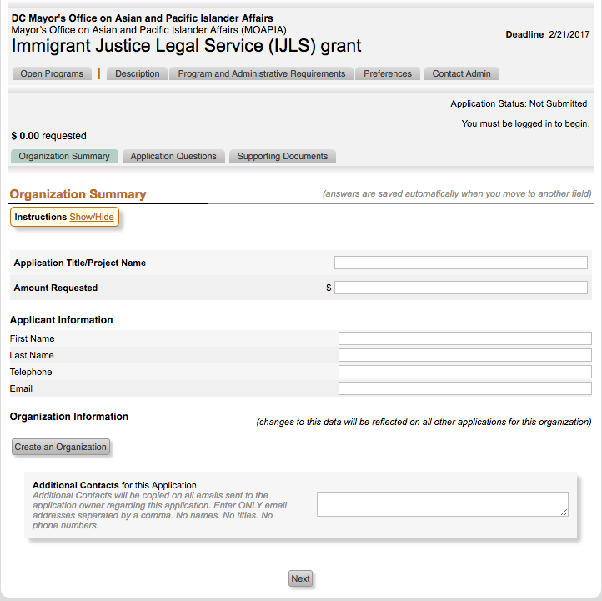
How to Apply using ZoomGrants
Step 1

Slide 15
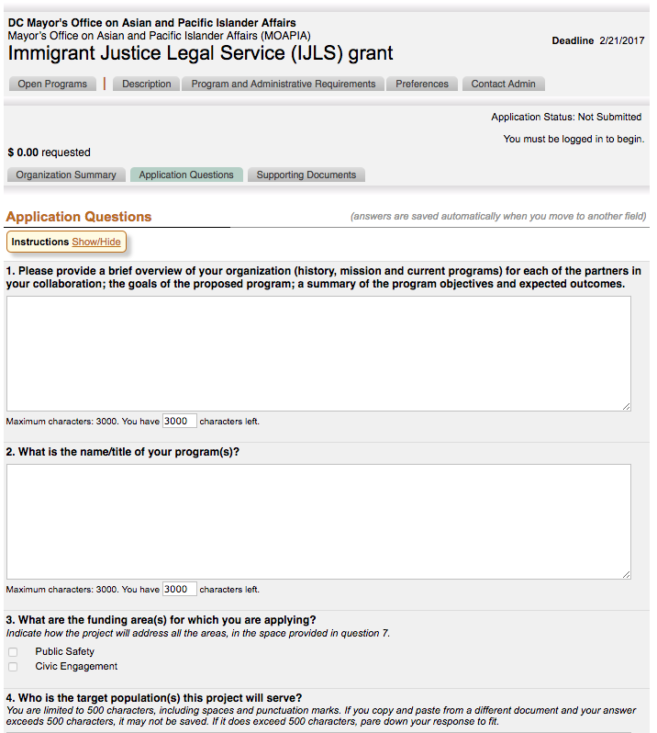
How to Apply using Zoom Grants
Step 2

Slide 16
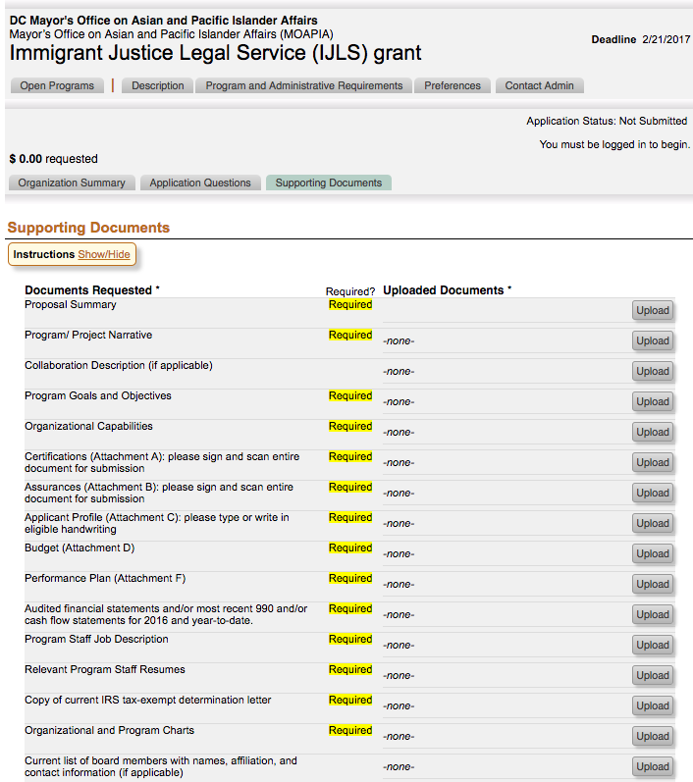
How to Apply for Zoom Grant
Step 3

Slide 17
Application Deadline
Deadline: August 13, 2018, 5 p.m.
The only method to submit an application is through ZoomGrants.

Slide 18
Scoring and Judging
Each application will have several levels of scoring and review:
From a panel of independent reviewers
From each of the Directors of the Mayor’s Office on Latino Affairs, Asian and Pacific Islander Affairs and African Affairs
From the Director of the Mayor’s Office on Community Affairs; the Mayor’s Office of Victim Services and Justice Grants; the Office of Partnership and Grants; and the Mayor’s General Counsel.

Slide 19
Scoring and Judging, Continued
Results of Past and Ongoing IJLS Grants, if any (+/- 10)
Soundness of the Proposal (20)
Goals, Objectives, and Services (30)
Applicant is able to track its progress towards goals and evaluate its program (5)
Organizational capability and relevant experience (30)
Sound fiscal management and budget (15)

Slide 20
Scoring and Judging, continued
Note that the highest scoring applications may not all win – we may need to make sure that all immigrants have access to services, or some program proposals may be uniquely important, even if they didn’t get the highest number of points.
The final grant agreements may differ from the proposals upon mutual consent – if, for instance, the budget was not fully funded, or the reviewers liked one aspect, but not another, of the application.

Slide 21
What’s Different This Year?
The Mayor requested, and the Council approved, more money for IJLS – increasing the budget by 80%.
The scoring of applications will have plus or minus ten points available for prior grantees, based on their performance.
Grant deliverables will be in fewer buckets so that we can more easily aggregate program results. We are focusing on: Education; Screenings and Brief Legal Consults; Full Representation; Results for Clients; and Capacity Building for Legal Help. Applicants may indicate other KPIs.

Slide 22
Cautions and Advice
Don’t start writing on the last day – a lot of attachments like Clean Hands Certificates and 990s are required.
Keep in mind this program is aimed at providing legal services – other District programs focus on other types of community outreach and connection to services, business development, language access.
Resolution in legal cases may take years, long after funding has ended, but we expect grantees to honor obligations to clients.

Slide 23
Review FAQ list Additional Questions?

