Slide 1
A Training on Improving Servicing Environment to DC’s Immigrant Populations
Presented By:
Office on African Affairs
Office on Asian and Pacific Islander Affairs
Office on Latino Affairs

Slide 2
Purpose and Outcome
Tangible recommendations on improving the servicing environment for the African, Asian/Pacific Islander, and Latino immigrants, residents and merchants.
Agencies gaining a better understanding on steps they can take towards improving service delivery to the African immigrant, Asian/Pacific Islander, and Latino communities

Slide 3
What will be covered?
Recap of previous assessments
Overview of current reports and research
What constitutes an ideal center?
Community/coordinators perspectives on front line centers (5 Themes)
Next Steps

Slide 4
Recap of Previous Assessments

Slide 5
Recap of previous assessments
Developed an assessment tool using Customer Service standards
Observed over 25 centers for the last two years
Prepared assessment reports of our findings

Slide 6
Overview of current reports and researCh

Slide 7
Overview of Current Reports and Research
Current Reports/Case studies
Summaries of Research

Slide 8
What constitutes an ideal center?

Slide 9
What is an ideal center?
An ideal center is defined as a welcoming environment to immigrant populations where they are able to navigate the center with ease and comfort.

Slide 10
What constitutes an Ideal Center?

Slide 11
Ideal Center Model: Entrance
Welcome sign (in multiple languages). Show office hours.
Language Access poster placed visually at the entrance (with different languages).
Make it clear to the client that all interpretation services are free (the poster that says you have the right to be served in your own language).
Translated Instructional Signs and/or signs with Symbols indicating operations.

Slide 12
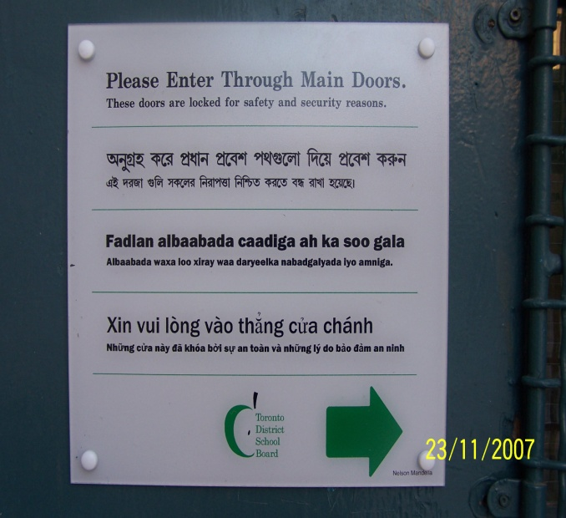
Examples of Entrance
Directing Visitors
What to post? Universal signage

Slide 13
Examples of Welcome Signs

Slide 14
Ideal Center: Information Desk/Ticket Place
“I speak” cards should be at the front counter in all languages
Translated signs indicating desk is for Information or Need to Take Ticket at Desk.
Trained desk staff member present to aid LEPs in acquiring an interpreter quickly and efficiently.
Translated Instructions of Next Steps from getting ticket to getting to counter
Access to Language Line

Slide 15
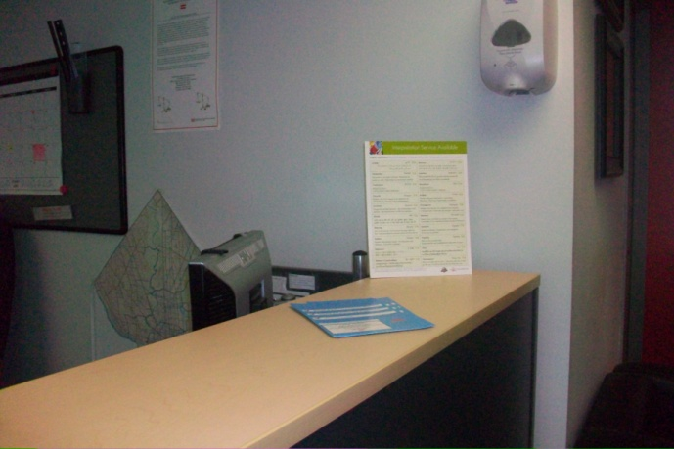
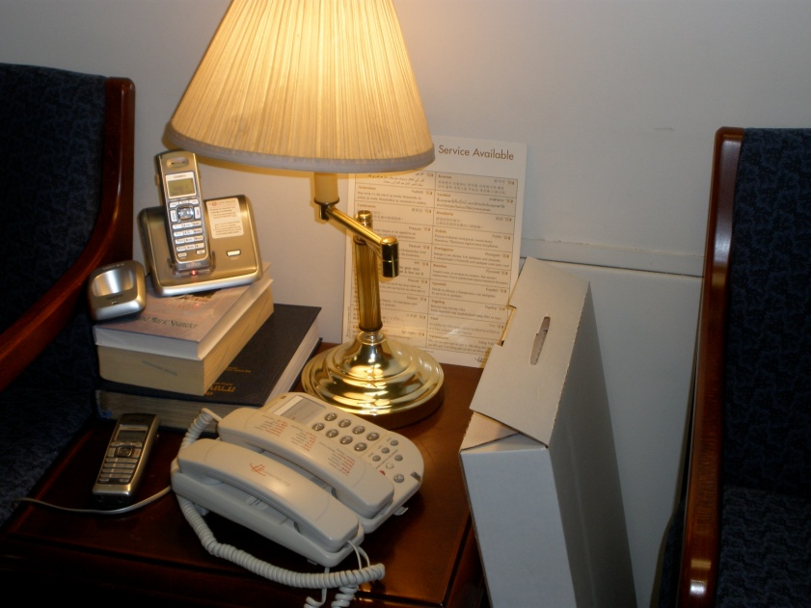
Examples of Information Desk

Slide 16
Ideal Center Model: Service Counter
“I speak” cards should be at the front counter in all languages.
Trained desk staff member present to aid LEPs in acquiring an interpreter quickly and efficiently.
Access to Language Line

Slide 17
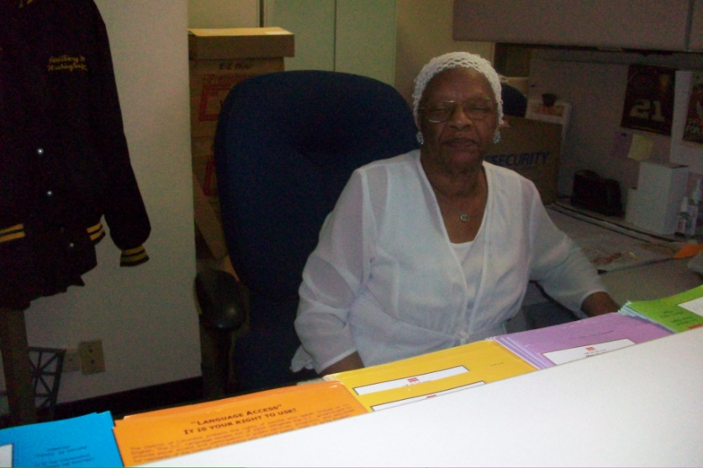
Examples of Service Counter

Slide 18
Community/Coordinators perspectives on front line centers (4 Themes)

Slide 19
Common themes from community and coordinators 1. Bilingual Staff and Staff Training 2. Interpretations/Translations 3. Signage, “I Speak” Card, and Language Line 4. Cultural Awareness

Slide 20
Theme 1: Bilingual Staff and Staff Training
Dr. Tedla Giorgis, Language Access Coordinator
Enrique Rivera, Language Access Coordinator
Julian Gonzalez, Interpreter

Slide 21
Bilingual Staff and Staff Training/Front Desk
The front desk is a very, very important piece in order to engage the LEP/NEP population.
Dr. Tedla Giorgis, Language Access Coordinator (Department of Mental Health)

Slide 22
Bilingual Staff and Staff Training/Knowing resources, available training
Part of that also is in training of staff, being able to train and let personnel know that these resources are available and that they can use them and tell them how to use them. And, for them to have that … awareness at all times, that they are able to access these resources … we’ve had complaints of folks who, you know, who are not properly served at a police district. Simply because the officer, didn’t think of picking up the phone and calling the language line because although the officer had tried to, made several efforts to obtain a bilingual person, speaking, who spoke this person’s language. He wasn’t able to, nobody was able to come to the location.
Enrique Rivera, Language Access Coordinator (Metropolitan Police Department)

Slide 23
Bilingual Staff and Staff Training/ Providing Information, Signage
If there’s nobody on the front desk that’s available to speak to them in their language that also makes it another obstacle for them to feel comfortable. And brochures or information before hand if they were not provided any information in their language also makes a difference to them. Signage you know if there’s no signage in their language, target language that also makes them feel scared or afraid.
Julian Gonzalez, Interpreter

Slide 24
Theme 2: Interpretations and Translations
Jennifer Hatton, Staff Attorney
Tereguebode Goungou, Language Access Coalition
Amy Vance, Language Access Coordinator

Slide 25
Interpretations and Translations
People not realizing that applications may be available or should be available in their language so if the fundamental problem is if agencies have it …translated applications and important documents…that’s the threshold issue. We make sure they have all those translations readily available. But they also need to be promptly displayed. I had a client, a Spanish speaker, who had been working with a particular office for nearly 10 years and didn’t know that he was supposed to get an application in Spanish and notices sent to him in Spanish and so it’s really important that information is prominently displayed. often … in that case there is also the … recurring situation of somebody who is trying to recertify for benefits and they may not get the notice in their language. May miss the recertification deadline and then have to start the application process all over again and in the meantime, their benefits whether, again, whether it’s a housing subsidy or food stamps or Medicaid or whatever … they can experience a gap in those benefits from the time that um they were terminated to the time that they reapply and again are approved. In those situations the harm could be relatively small or could be very big. You can imagine a situation in which, somebody’s Medicaid is terminated for failure to recertify or and then it may take them some time to get back into the office to reapply, get approved again and in the meantime may be going to their doctors and racking up all this medical debt. And so, it can really … sort of spiral out of control in that way
Jennifer Hatton, Staff Attorney (Legal Aid Society)

Slide 26
Interpretations and Translations
The best way to serve this population is having this, umm, uh… the translation of the document that uh are very um important that are very useful to them the way they can understand the services that they serve, the agencies are offering. So, um … the interpretations too is the most important one because when they enter the service the first person they talk to needs to know about what NEP and LEP means and uh how you can interact with these people if you don’t understand, um you don’t speak their language. So it’s the first thing I want to say is very important to and especially it’s cultural … thing with us. When you come to this country and we feel like we are not much welcome or very welcome to some places. So when you enter the first person you talk to will let you feel comfortable in these services.
Tereguebode Goungou, Language Access Coalition

Slide 27
Interpretations and Translations
We also spend a lot of time translating meeting notices and project related materials as well as providing interpretation services … and we provide these services based on demographic information but we also base it on requests that come in through the community and the knowledge that our work planners and project managers have of the community.
Amy Vance, Language Access Coordinator (DC Department of Transportation)

Slide 28
Theme 3: Signage, “I Speak” Card and Language Line
Julian Gonzalez, Interpreter*
Jennifer Hatton, Language Access Coalition
Leo Albornoz, Language Access Coordinator

Slide 29
Signage, “I Speak” Card and Language Line
Something that’s easy for them to understand in their own way and also that they can take information home if they want to you know to have the information there and they can pick it up and take it home with them to have numbers, contact’s information that they can follow.
Julian Gonzalez, Interpreter

Slide 30
Signage, “I Speak” Card and Language Line
One really positive experience is with our clients who we have, first of all, informed them of their language access rights and second equipped them with one of the Office of Human Rights’ I Speak Cards. I mentioned earlier a client of mine who had been working with a particular government agency for nearly ten years completely unaware of the availability of language services until I told him about it. I gave him one of OHR’s I Speak Cards and he immediately started using it, not only at that agency but, everywhere else he went. And he’s been doing that for nearly a year now and I check in with him periodically even though his case is now closed. And he tells me that he’s had many positive experiences at agencies now and anytime that he has presented the I Speak Card he has gotten services that he needed right away. So that has been a really hopeful experience and that’s reinforced our commitment to try and educate our clients and try to get that information in their hands because it’s so easy it’s a helpful reminder to them that they have theses rights and it’s a helpful reminder to the frontline staff at the agencies about what they need to do and how to do it.
Jennifer Hatton, Language Access Coalition (Legal Aid Society)

Slide 31
Signage, I Speak Card, and Language Line
It’s just the limitations of bilingual staff we don’t have unfortunately as many other government agencies we don’t have the numbers that we would like to have so we rely heavily on the usage of the language line.
Leo Albornoz, Language Access Coordinator (Department of Parks and Recreation)

Slide 32
Theme 4: Cultural Awareness
Enrique Torrico, Non-profit Organization*
Tedla Giorgis, Language Access Coordinator
Isabel Van Isschot, Non-profit Organization

Slide 33
Cultural Awareness
I think there is a mix and it has to do to a large extent with two factors. One is whether they speak English or not or a little English or they understand some English. And also to what extent they are culturally savvy. And they know how the system works. That’s on the client’s side. But also on the provider’s side is to what extent they are culturally sensitive and they are aware that people may come with just limited knowledge of how things work. To what extent they are sensitive but also … I would say to some extent even caring. I’ve seen and I’ve heard information enough from one particular office but sometime … the services … just not, I don’t want to say just not sensitive enough like if they wouldn’t care whether they come or not. And I think there is a variety, again.
Enrique Torrico, Family Institute Director (CentroNia)

Slide 34
Cultural Awareness
Six languages, like Spanish, Amharic, Vietnamese, Chinese, Korean and, and French. Um, eh, and also the staff is culturally competent. What I mean is, more like, for example, our staff has been trained in terms of therapeutic interventions. How to engage, persons from different cultures, you know for example. You know, if an Ethiopian comes, you know you cannot just draw an intake in, in two hours or in the first intake. It just takes time. It’s just like onion peeling, you know. They are not going to tell you everything, you know, because you are a stranger, that’s not what they are used to. So we take our time, to engage them and take our time, unlike you know maybe … those who have acculturated here, who’ll just come and tell you everything you need to know right there and then and you’ll go to the next stage immediately.
Dr. Tedla Giorgis, Language Access Coordinator (DMH)

Slide 35
Cultural Awareness
I wanted to say to … answer to your question that some of … the clients you have interviewed have said that they would prefer, that some of the ….members of the same community that work in DC agencies, sometimes they feel mistreated by them. Well, a good way for the government to … address that problem is uh to make sure that when they hire someone … that they … they’re, they’re … culturally sensitive to their own community … that and that they go through training and not only culturally competent training that sometimes are not … do not necessarily address these issues. But a training on… prejudice. And how to leave that … how to provide a professional … service without ….mixing your own prejudices in, I don’t know , I don’t think that’s possible but training, it’s important. Training and having the right people. And that if you can catch that during the interview process … that would be a good thing.
Isabel Van Isschot, Interpreter Services (La Clínica del Pueblo)

Slide 36
Additional Ideas
Individual Meetings at Centers—Helping to navigate the system
Translation use as support of face-to-face interaction
Identifying target populations (who is there, and who should be there)

Slide 37
Suggestions from the Community
Michael Dalious, Non-profit Organization
Isabel Van Isschot, Non-profit Organization
Amy Vance, Language Access Coordinator

Slide 38
Suggestions from the Community
Another important aspect of those events is that when the participants arrive uh to make them feel more comfortable it helps to have an order to the services. We had Kathy Ramirez was there last Saturday and she was taking folks and she was helping them through each station. I think one of the problems with limited proficiency is that you come to an event and you’re not quite sure where to start and once you’ve started you’re not quite sure where to go next. And I think one of the things we can do is kind of help folks understand maybe a flow to the event and kind of show them that you really want to take advantage of all these services. You can start here and go here and here and here and end over there. I think that helps folks go through kind of every stage. If you let them come and maybe they’ll pick up one or two things that looks appealing to them and miss a lot of information. So one of the things that I think we’ve been doing a better job with more recently is to kind of have it be a little more explicit how folks can go through an event and kind of partake in everything. And it makes it easier if the uh person who has just kind of established a rapport with someone in the event says to that person at the end of their visit, “Why don’t you go next door and the department of so and so is here providing this information.” If we can just make little referrals or little introductions it makes everyone a little more comfortable.
Michael Dalious, Health Fair Coordinator (La Clínica del Pueblo)

Slide 39
Suggestions from the Community
Our patients, …. many of them are not only limited English but they have limitations in their own language. Many of them are … do not know how to read and write in Spanish so, its, it’s important to have information in writing because they may have family members that help read them. As that …to reinforce the information you are providing to them., but especially you can find out if there is a family member who can help … read them or…for example, what Michael was saying about the oral information…it’s really key, … for the community we serve. It’s very important to give that information orally … in the language the patient can or the client can understand.
Isabel Van Isschot, Interpreter Services (La Clínica del Pueblo)

Slide 40
Suggestions from an agency
We have these forms, actually it’s a civil rights compliance form, that anytime we hold or attend a meeting the project manager has to fill out this form … and it includes questions: how many LEP/NEP individuals attended the event; how many ‘I Speak’ cards did you distribute, how many ‘I Speak’ cards did you collect, how many clients did you come in contact with. So we track that for every meeting or event and this is the first year we are doing it and that is particularly helpful because not only can it help us plan for our language access program but it also shows us areas that we are falling short in. If we held a meeting in we know there is a large Spanish speaking population and know Spanish speakers showed up we need to do something differently, so that has been very helpful in that regard.
Amy Vance, Language Access Coordinator (DDOT)

Slide 41
Next steps

Slide 42
Next Steps

Slide 43
Questions/Comments
Office on African Affairs
Heran Sereke-Brhan, heran.sereke-brhan@dc.gov
Office on Asian and Pacific Islander Affairs
Neel Saxena, neel.saxena@dc.gov
Office on Latino Affairs
Cecilia Castillo Ayometzi, cecilia.castillo@dc.gov

